Slide 1
Triangle Proofs
Have your theorem/postulate handout, ISN

Slide 2
Do Now
https://youtu.be/0YahlaJVvpo
On the left side, title “Do Now”
Write 3 things big ideas
Write 2 things that clicked a.k.a. “A Ha!” moment
Write 1 question you have

Slide 3
Objective and Essential Q
Objective:
Essential Question: How can you find the missing measures of a triangle?

Slide 4
Agenda
Do Now
Business
Triangle Sum Thm, Triangle Sum Thm Corollaries, Exterior Angle Thm
Third Angle Thm,
Exit Ticket Summary

Slide 5
Business
Homework:
Honors: 4.2 pg 228 #24-28 Regular: 4.2 #19-24?
Honors: 4.3 pg 235 #17-21 Regular: 4.3 pg 234 #9-11
For your art project:
Read 4.4-4.5
Think and Discuss Question in note taking section:
4.4 pg 245 #1 and #2 (optional #3)
4.5 pg 255 #1 and #2 (optional #3)
Construction practice for art project:
SAS p243
ASA pg 253

Slide 6
Business
Make sure your missing work is addressed and turned in
If you are still missing syllabus or consent forms I NEED THOSE !!
Have your ISN out before you come to class i.e. take it out on your last period or before school/lunch

Slide 7
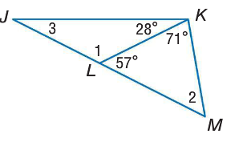
Triangle Sum Theorem Find the measure of the numbered angle

Slide 8
Triangle Sum Corollaries
For <2 <3 <4

Slide 9
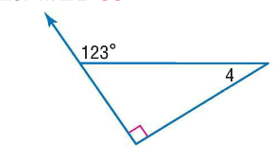
Exterior Angle Theorem Find the measurement of angle 4

Slide 10
Reflection
Come up with a headline for a newspaper using our lesson’s big ideas i.e. triangles, angle measurements, theorems, finding x

Slide 11
Triangle Proof Cont’d
Objective: same purple … prove triangles are congruent using the definition of congruence
Essential Question: Why is the order of vertices important when naming congruent triangles?

Slide 12
CPCTC

Slide 13
Third Angles Theorem

