Slide 1
Writing Proofs
Take out weekend homework, ISN, MVP Packet, coloring tools

Slide 2
Do Now
Go over homework within your group;
Reflection and Summary Share out

Slide 3
Writing Proofs- Developing Sound Conjectures
Objective: Students will use inductive reasoning to make conjectures.
Essential Question: How can you make a conjecture and prove that it’s true?

Slide 4
Agenda
Do Now
Business
5.5 Conjectures and Proof Activity

Slide 5
Business
Homework:
Review for Quiz: pg 127 2.6-2.7; pg 181 for 3.1. I will not be questioning you on what we have done in the Accountability Quiz. Come Thursday ready for questions
5.5 Ready Get Go! (will help with reviewing)
Consent Forms, have signed and returned by Thursday

Slide 6
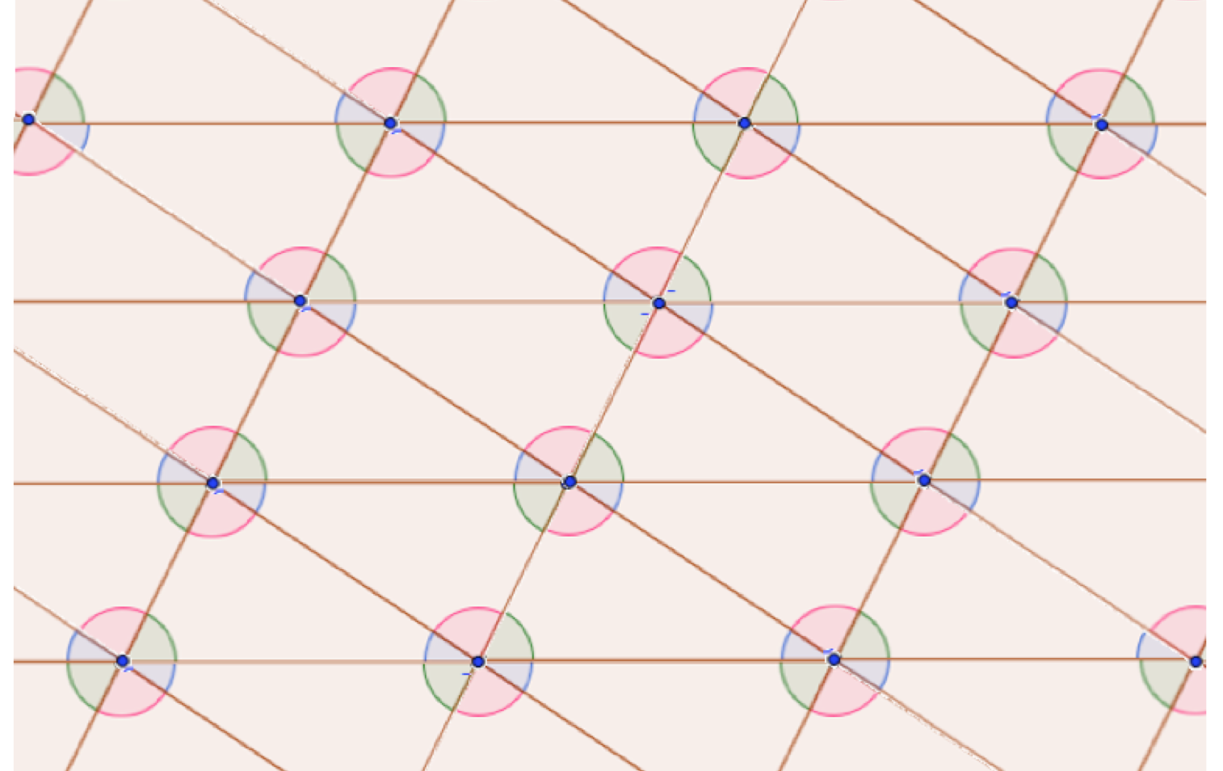
Conjectures and Proofs

Slide 7
Vocabulary for this section
Vertical Angles
Exterior Angle- the angle formed by any side of a polygon and the extension of its adjacent side
Remote Interior Angle-two angles that inside the triangle and opposite from the exterior angle
Alternate Interior Angles
Corresponding Angles
Same-Side Interior Angles

Slide 8
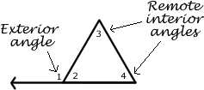
Notes

Slide 9
Corresponding Angles
The Diagram was formed by rotating each triangle about the midpoint of one its sides
The triangles have also been translated in the same direction and same distance as each of the individual sides
Also note all parallel lines are horizontal
Using 3 colors, mark corresponding angles in the diagram and work on conjectures

Slide 10
Reflection
Make a conjecture about the Presidential campaign and provide reasoning as to why you chose that President

Slide 11
Conjectures and Reasoning
If two parallel lines are cut by a transversal, then the corresponding angles are congruent (postulate)
In the tessellation I know all the triangles are congruent because of the image preservation caused from rotating or translating an image. From the tessellation diagram, I notice there are 3 corresponding angle pairs respectively match the 3 interior angles of a triangle.

Slide 12
Vertical Angles
If two angles are vertical, then they are congruent
From the Image I notice all the angles form linear pairs, angles 1 and angle 2, angle 2 and angle 3, angle 3 and angle 4, and lastly angle 1 and angle 4. From the tessellation diagram, I also know the linear pairs have a sum of 180 due to the sum of the interior angles forming a half circle. Since angle 1 and angle 2 add up to 180 and also angle 2 and angle 3 add up to 180, then angle 1 and angle 3 must be congruent

Slide 13
Exterior Angles of a Triangle
A measure of of an exterior angle of a triangle is to to the sum of the measures of the two remote (non-adjacent) interior angles of the triangle.
Every triangle interior angle is marked with a designated color. In the tessellation diagram, I notice the exterior angle of any interior angle from the triangle is composed by two remaining colors which indicate different interior angles. The two remaining colors also happen to indicate the location of the remote angles. Therefore I believe the exterior angle is the sum of interior angles

Slide 14
Parallel lines cut by a transversal
If two parallel lines are cut by a transversal, then corresponding angles are congruent, alternate interior angles are congruent, alternate exterior angles are congruent and same side-interior angles are supplementary.

Slide 15
Reflection
Make a conjecture about who will be elected president (NOT who you do not want for president and start hate bashing). Provide reasoning as to your chosen candidate. Keep it 2-3 sentences

Slide 16
Essential Question
How can you make a conjecture and prove that it’s true?
2-3 sentences requirement for all Summary of Essential Question.
I will be checking ISN this Friday, and points from last ISN can be made up by this Friday also. Extension for the reason that I know most students are struggling with the concept

Slide 17
Paragraph Proof
Quadrilateral paragraph Proof from homework (polygon with 4 sides) skip for right now until I show you tomorrow how to write a paragraph proof and provide the properties, theorems, definitions, postulate handout

